Slide 1


DTC BUS GUIDE
By:
SAKsham Arora
05415002717
CSE-2(M)
25

Slide 2
Needs And Objectives
This application is needed due to the unfamiliarity of people with the bus routes in Delhi, as they are very complex. Most of the people are unaware that which bus to board and where to interchange to reach their destination by applying minimum efforts, according to their needs.
Unavailability of application about Delhi bus Services.
The aim of this project is to prepare a user-friendly application, from which a user can easily get to know about the Delhi bus services, and can go to his/her destination conveniently.

Slide 3
Implementation what why & how

Slide 4
Trie
A Trie is a special tree-like data structure, wherein characters of a string are stored as nodes. Trie is an efficient information reTrieval data structure.
Using Trie, prefix search complexities can be brought to an optimal limit (key length).
It is used because of the fact that we will have to do prefix search, as bus stands have long and complex names.

Slide 5
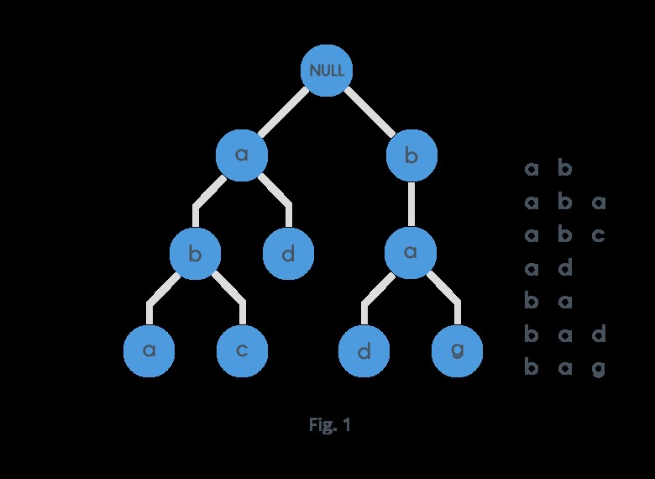
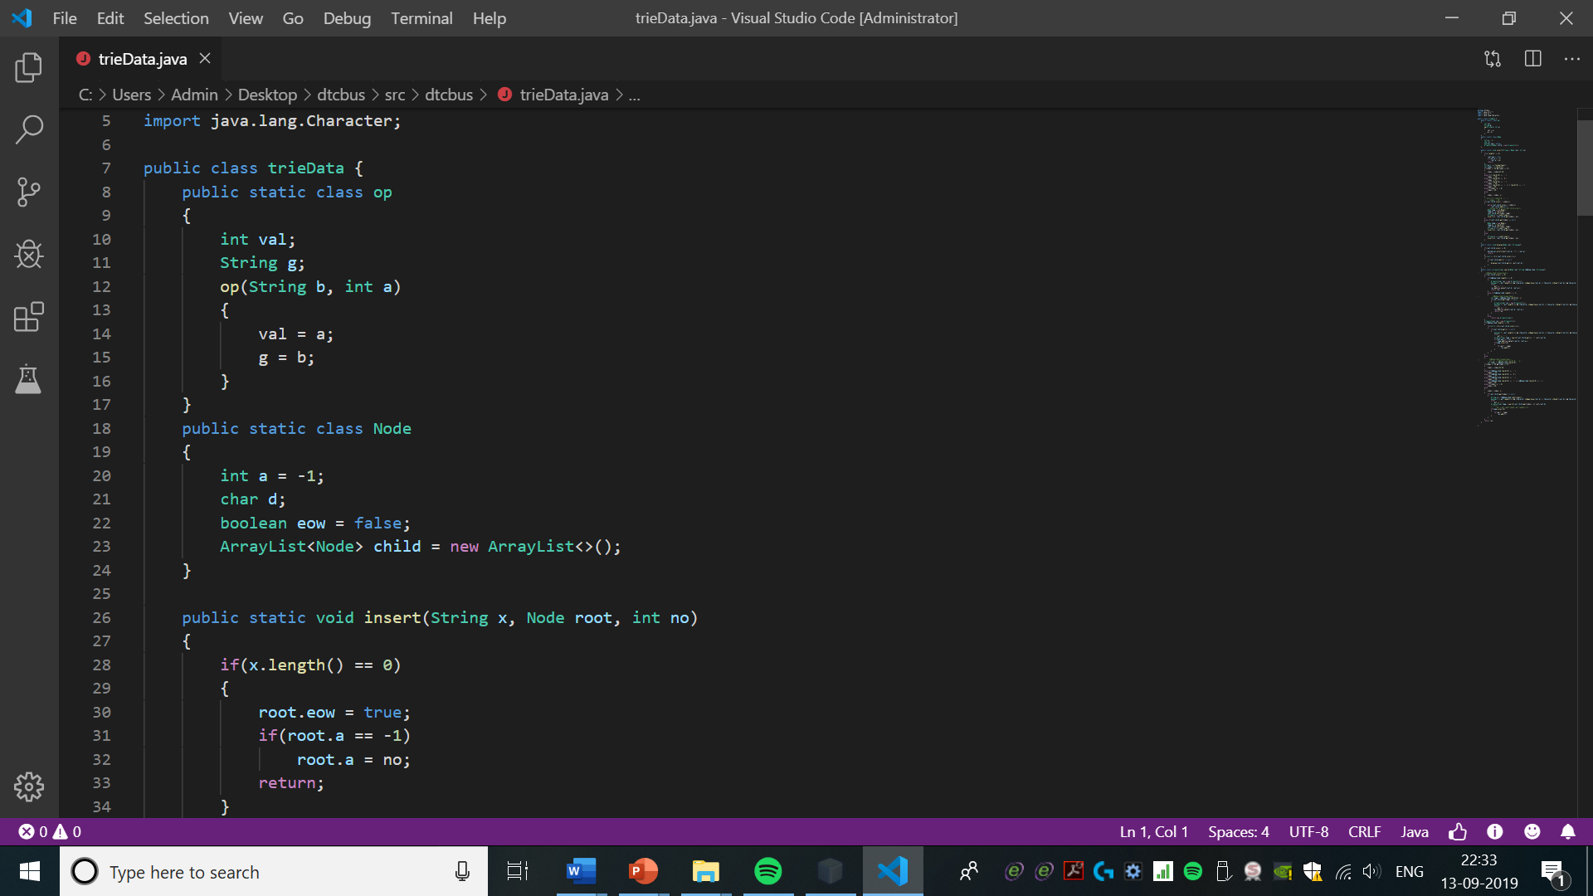
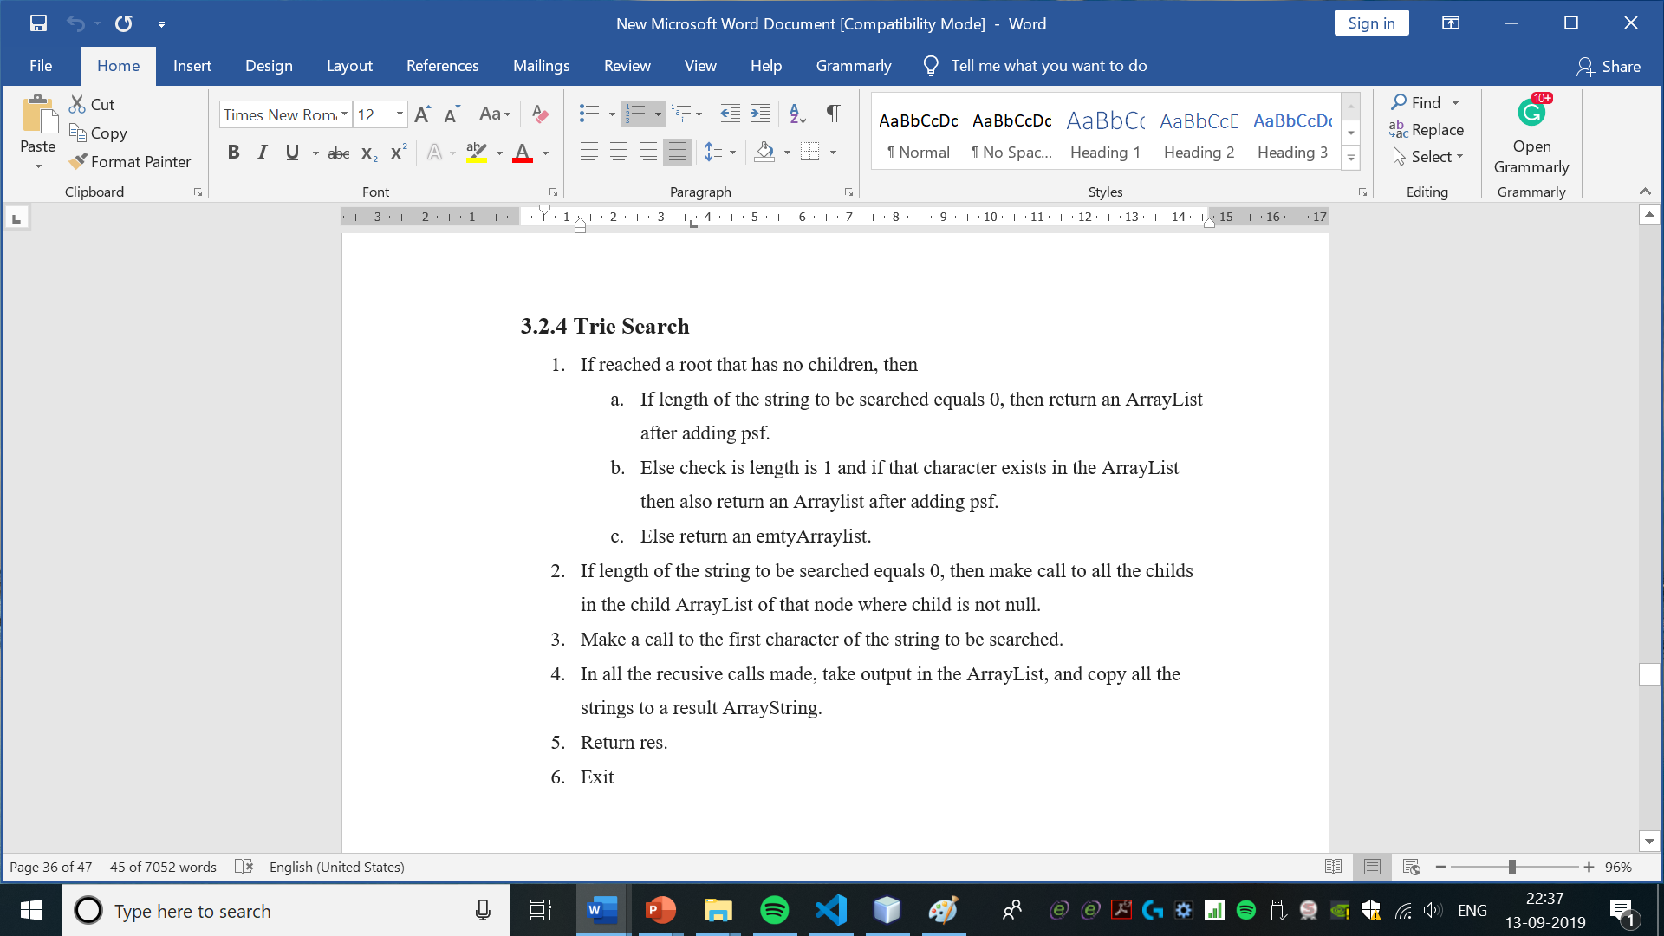

Slide 6
GRAPHS
Graphs are mathematical structures that represent pairwise relationships between objects. A graph is a flow structure that represents the relationship between various objects.
Graphs are used to represent many real-life applications: Graphs are used to represent networks. The networks may include paths in a city or telephone network or circuit network.
Graphs are also used in social networks like LinkedIn, Facebook.

Slide 7
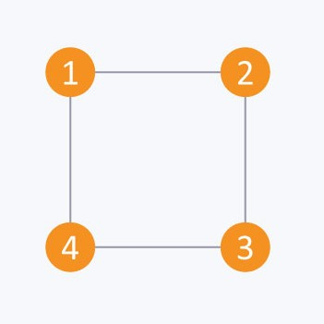
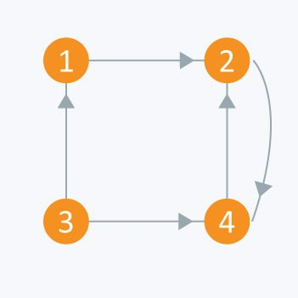
Types Of Graph Used
Bidirectional/undirected graph
unidrectional/directed graph
It is a graph in which all the edges are bidirectional, i.e, if there is an edge (u,v) then (v,u) also exists.
It is a graph in which all the edges are unidirectional, i.e, if there is an endge (u,v), then (v,u) may exist.

Slide 8
Breadth-first search (BFS)
A breadth-first search (BFS) is a technique for traversing a finite graph.
BFS visits the sibling vertices before visiting the child vertices, and a queue is used in the search process.
It gives more preference to sibling rather than children.
One of the application of this algorithm is to find the shortest path from one vertex to another.

Slide 9
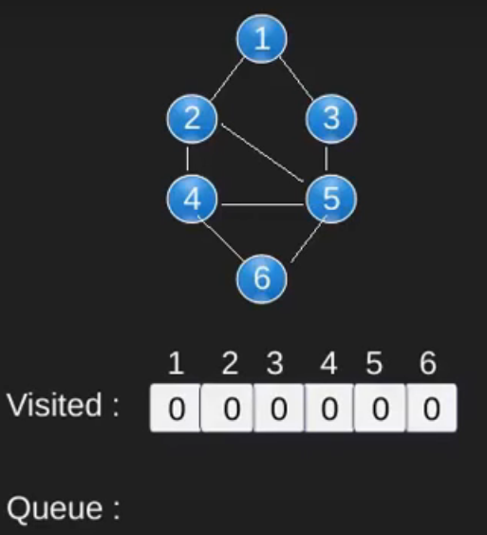
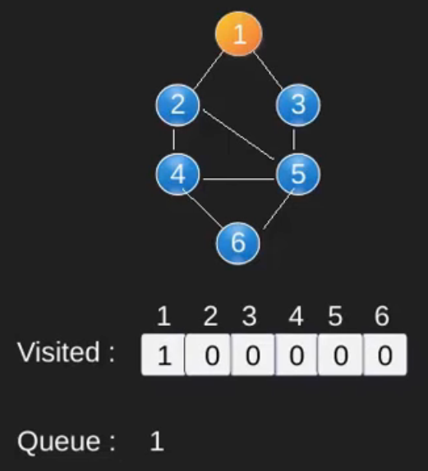
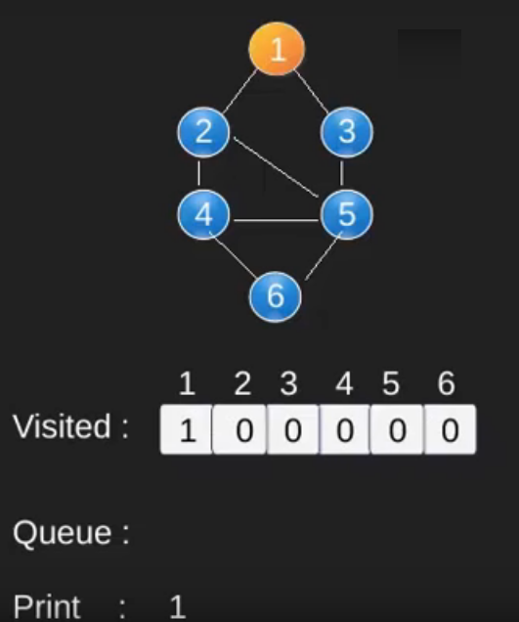
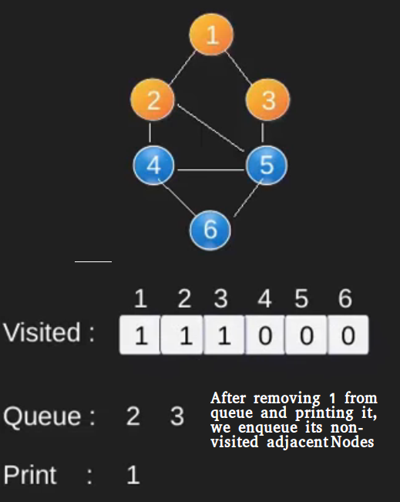
How BFS WORKS ??

Slide 10
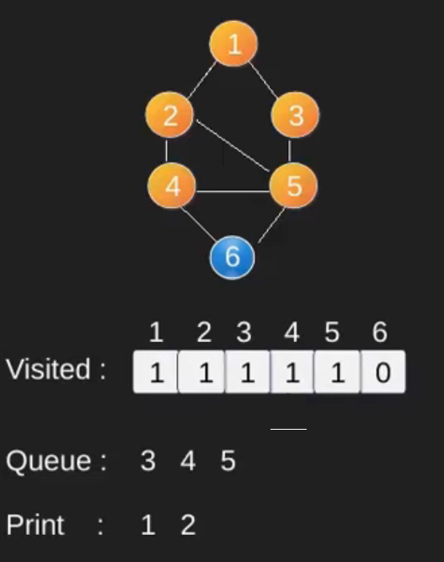
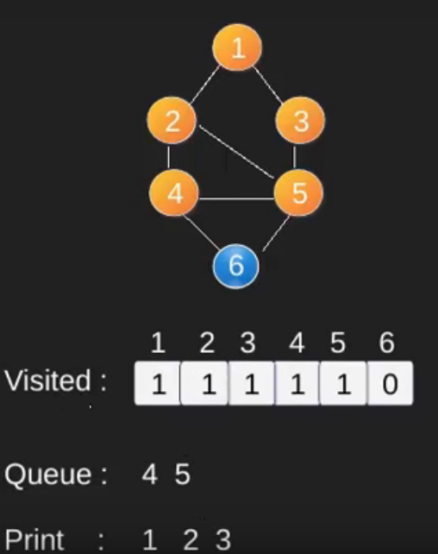
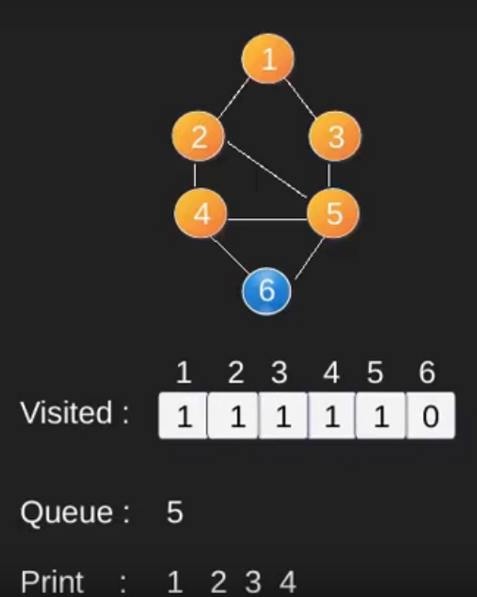
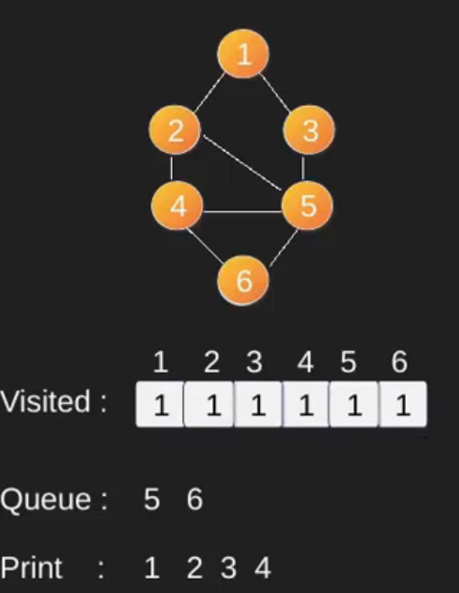
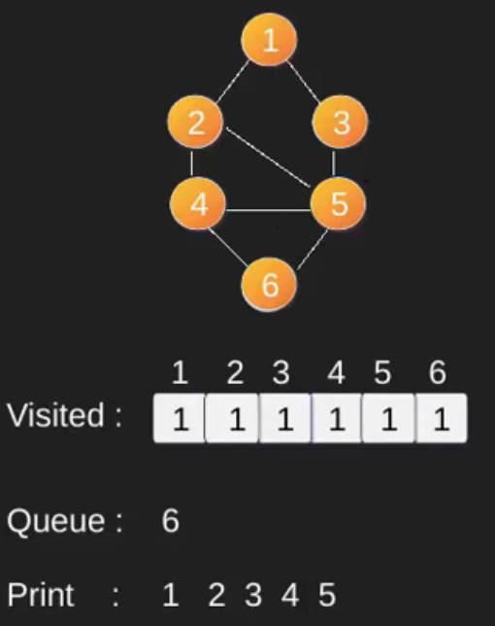
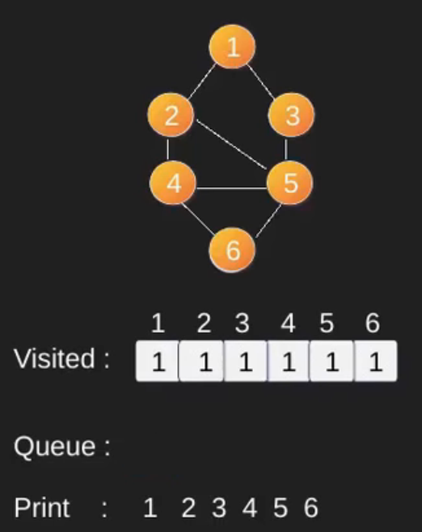

Slide 11
The project can divided in four screens

Slide 12
Home window

Slide 13
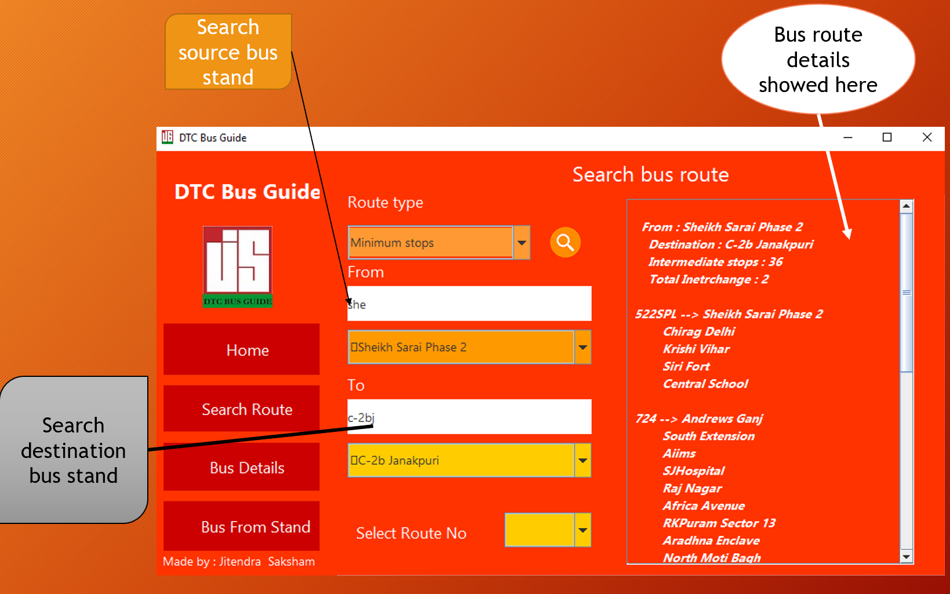
Search window

Slide 14
BUS Details window

Slide 15
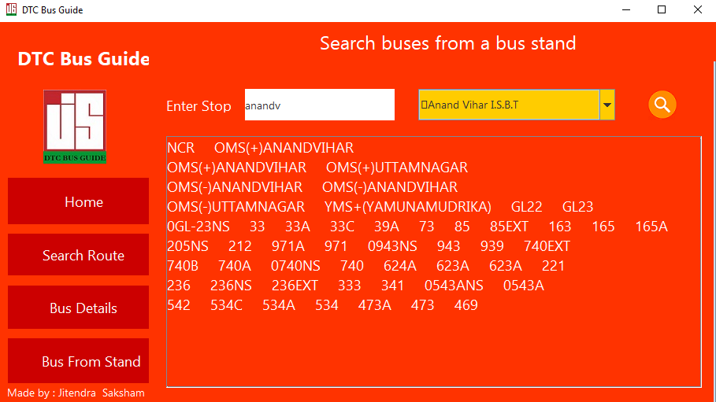
Bus stand info window

Slide 16
RESULT And Conclusion
All the modules have been successfully implemented.
It is concluded that Trie saves time in prefix search.
It is concluded that BFS is superior than DFS when it comes to finding shortest path.
The application is platform independent and in working condition.

Slide 17

Thank You…

